Slide 1
GitHub OAUth2
Using Haskell’s Yesod-Stack

Slide 2
GitHub OAuth
OAuth stands for Open Authentication protocol and allow for secure data sharing.
Here it will be demonstrated how to set up an OAuthentication using Haskell’s yesod web framework.

Slide 3

Yesod web framework
The Yesod web framework allows for an easier web frame setup when using Haskell.
The Stack-Yesod framework enables for templates of projects to be easily altered for one’s use.

Slide 4

yesod-sqlite
For purposes of this demonstration the Yesod-Sqlite project template was chosen.
The project template comes with a number of extra components to enable basic oauth with a dummy website.

Slide 5

Getting Your Client ID and Secrets from GitHub
In your GitHub settings you can set-up a Developer application for OAuth, and obtain a client ID and client secret.
clientId :: Text
clientId = “XXXXXXXXXXXXXXXXXXXXX"
clientSecret :: Text
clientSecret = “XXXXXXXXXXXXXXXXXXXXXXXXX"

Slide 6
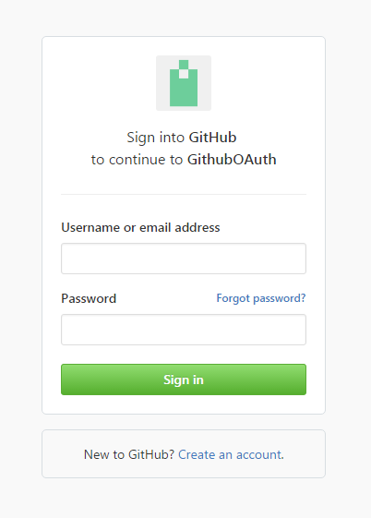
Inserting Your Client ID and Secret into and enabling Github Oauth in Stack
Using the Foundation file in stack you can paste in your client Id and Secret.
Similarly, by editing authPlugins app to use the Github Oauth2 package and take in your clientID and ClientScret.
After adding the external dependencies you should be able to access the GitHub Oauth service when running stack.

Slide 7
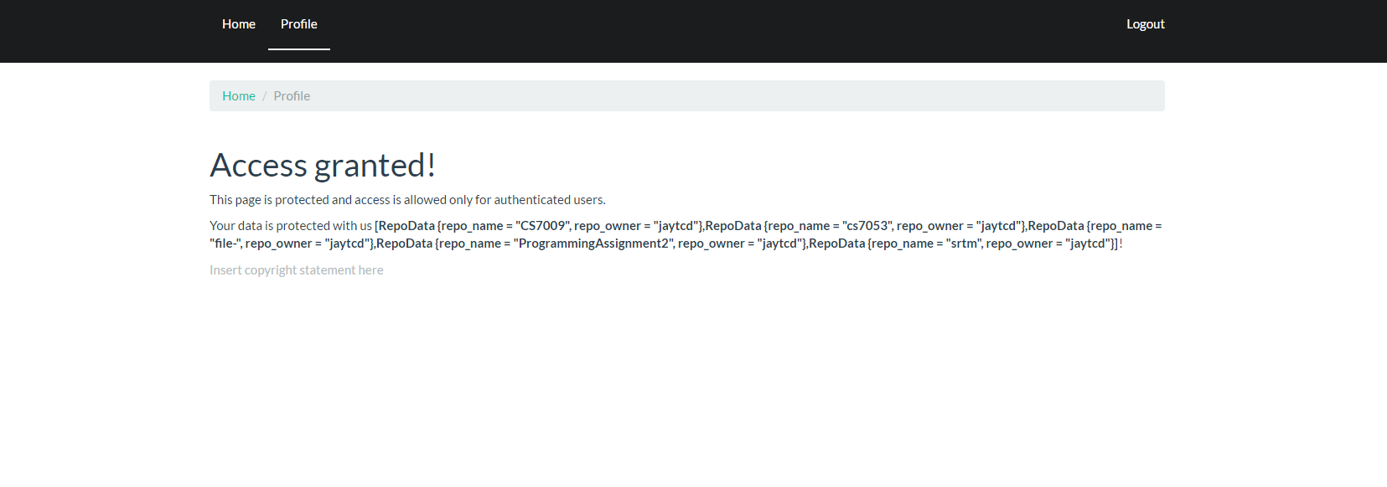
Getting user Information
By editing the profile file in the handler folder of your stack project, you should be able to retrieve information from GitHub using the user’s token.
As seen on the left, where my repo data was displayed after the login and token stages have been completed.

Slide 8
References
Barrett, S. (2017). CS7009. [online] Scss.tcd.ie. Available at: https://www.scss.tcd.ie/Stephen.Barrett/lectures/cs7009/.
Yesodweb.com. (2017). Authentication and Authorization :: Yesod Web Framework Book- Version 1.4. [online] Available at: http://www.yesodweb.com/book/authentication-and-authorization.
https://hackage.haskell.org/package/github-0.13.2
https://github.com/phadej/github

